Slide 1
Fungal Diseases of Sugarcane
Dr. Suresh Chand Mali
(Assistant Professor)
Department of Botany
Veena Memorial PG College, Karauli

Slide 2
Introduction
Sugarcane (S. ofﬁcinarum L.) is a monocotyledonous plant.
From the family Poaceae of the subfamily Andropogoneae.
Over 100 fungi, 10 bacteria, 10 viruses and about 50 species of nematodes are pests of sugarcane in different parts of the world .
About 56 diseases of sugarcane reported so far from different parts of the world. Of these, 40 are caused by fungi.

Slide 3
List of Fungal Diseases of Sugarcane
Fungal Diseases | Causal Organism
Banded sclerotial (leaf) disease | Thanatephorus cucumeris = Pellicularia sasakii
Black rot | Ceratocystis adiposa
Black stripe | Cercospora atrofiliformis
Brown spot | Cercospora longipes
Brown stripe | Cochliobolus stenospilus Bipolaris stenospila
Downy mildew | Peronosclerospora sacchari = Sclerospora sacchari
Downy mildew, leaf splitting form | Peronosclerospora miscanthi = Sclerospora mischanthi Mycosphaerella striatiformans
Eye spot | Bipolaris sacchari = Helminthosporium sacchari
Leaf blast | Didymosphaeria taiwanensis

Slide 4
List of Fungal Diseases of Sugarcane Contd.
Fungal Diseases | Causal Organism
Fusarium sett and stem rot | Gibberella fujikuroi Fusarium moniliforme Gibberella subglutinans
Iliau | Clypeoporthe iliau = Gnomonia iliau Phaeocytostroma iliau
Leaf blight | Leptosphaeria taiwanensis Stagonospora tainanensis
Leaf scorch | Stagonospora sacchari
Marasmius sheath and shoot blight | Marasmiellus stenophyllus = Marasmius stenophyllus
Myriogenospora leaf binding (tangle top) | Myriogenospora aciculispora
Phyllosticta leaf spot | Phyllosticta hawaiiensis
Phytophthora rot of cuttings | Phytophthora spp. Phytophthora megasperma
Red leaf spot (purple spot) | Dimeriella sacchari

Slide 5
List of Fungal Diseases of Sugarcane Contd.
Fungal Diseases | Causal Organism
Pineapple disease | Ceratocystis paradoxa Chalara paradoxa = Thielaviopsis paradoxa
Pokkah boeng (that may have knife cut symptoms) | Gibberella fujikuroi Fusarium moniliforme Gibberella subglutinans
Red rot | Glomerella tucumanensis = Physalospora tucumanensis Colletotrichum falcatum
Red rot of leaf sheath and sprout rot | Athelia rolfsii = Pellicularia rolfsii Sclerotium rolfsii
Red spot of leaf sheath | Mycovellosiella vaginae = Cercospora vaginae
Rhizoctonia sheath and shoot rot | Rhizoctonia solani
Rind disease (sour rot) | Phaeocytostroma sacchari = Pleocyta sacchari = Melanconium sacchari

Slide 6
List of Fungal Diseases of Sugarcane Contd.
Fungal Diseases | Causal Organism
Ring spot | Leptosphaeria sacchari Phyllosticta sp.
Root rots | Marasmius sacchari Pythium arrhenomanes Pythium graminicola Rhizoctonia sp. Unidentified Oomycete
Rust, common | Puccinia melanocephala = Puccinia erianthi
Rust, orange | Puccinia kuehnii
Schizophyllum rot | Schizophyllum commune
Sclerophthora disease | Sclerophthora macrospora
Sheath rot | Cytospora sacchari
Smut, culmicolous | Ustilago scitaminea
Target blotch | Helminthosporium sp.
Veneer blotch | Deightoniella papuana

Slide 7
List of Fungal Diseases of Sugarcane Contd.
Fungal Diseases | Causal Organism
Seedling blight | Alternaria alternata Bipolaris sacchari Cochliobolus hawaiiensis Bipolaris hawaiiensis Cochliobolus lunatus Curvularia lunata Curvularia senegalensis Setosphaeria rostrata Exserohilum rostratum = Drechslera halodes
White rash | Elsinoë sacchari Sphaceloma sacchari
Wilt | Fusarium sacchari = Cephalosporium sacchari
Yellow spot | Mycovellosiella koepkei = Cercospora koepkei
Zonate leaf spot | Gloeocercospora sorghi

Slide 8
Major Fungal Diseases of Sugarcane
Red Rot Disease of Sugarcane
Sugarcane Smut Disease
Sugarcane Rust Disease
Sugarcane Eye Spot Disease
Pokkah Boeng Disease
Pineapple Disease of Sugarcane

Slide 9
Red Rot Disease of Sugarcane
First described from Java by Went (1896)
Then the disease was reported from Australia, India, Hawaii and the USA.
Butler gave name- Red rot
Widespread and virulent in North Bihar and Eastern part of the United Provinces during 1939 and 1942.

Slide 10
Symptoms
Appear after rainy season when plant growth stop and sugar formation starts
Yellowing of third leaf from top starts
Juice- Bad odour and do not set well on boiling due to conversion of sucrose into glucose
Stalk symptom-
Presence of white spots in otherwise rotten (dull red) internodal tissues and nodal rotting [white patches are speciﬁc to the disease and are of signiﬁcance in distinguishing red rot from other stalk rots. ]
Shrinking and discoloration of rind
Infected cane later become shriveled.
Pith cavity filled with grayish mycelium
Cane light in weight and easily broken
Minute dot like structures (acervuli) near the diseased node
Leaf Symptom-
elongated red lesions on the midribs
the lesions may develop a straw color in the center
reddish patches on the leaf sheaths
infrequently, small dark spots on the leaf blades
Seed Pieces symptoms-
the entire seed piece may become rotten
the internal tissues turn various shades of red, brown or grey

Slide 11
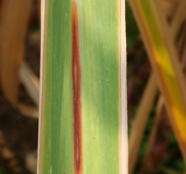
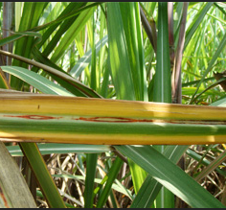
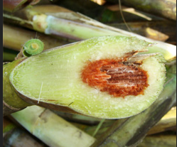
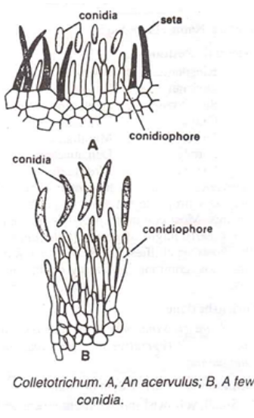
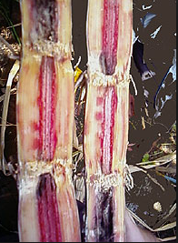
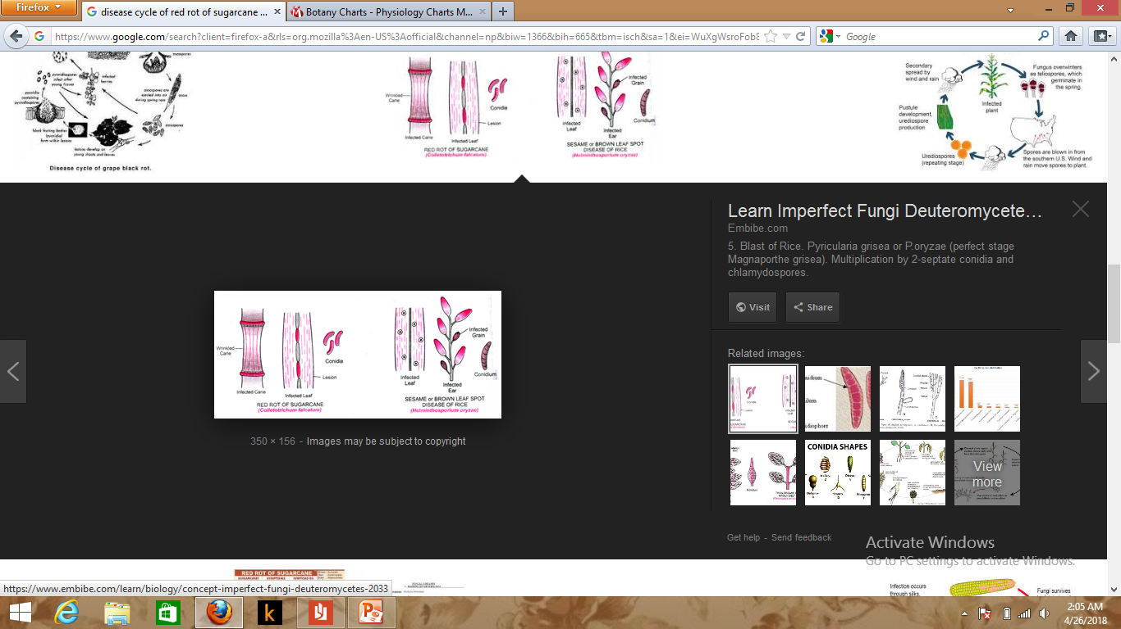
Reddish lesion on midrib
Orange to yellow leaf
Inner region with reddish color
Central tissue of stem

Slide 12
Causal Agent
Caused by Colletotrichum falcatum known by its imperfect state, i.e. Glomerella tucumanensis
Conidia- falcate (but not markedly so), fusoid, apices obtuse
- contents are granular and sometime contain oil globules.
The variations in the asexual state of the fungus (Colletotrichum state) may originate through-
(i) heterokaryosis
(ii) by recombination through parasexual mechanism and
(iii) by the universal mechanism of mutation, selection and adaptation in response to the changes in the host environment.

Slide 13
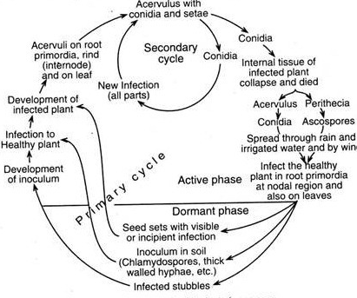
Disease Cycle and Pathogenesis

Slide 14
Preventive Measures
Cultural method:
The best way to control red rot is to select setts for planting from healthy plants in a disease- free area.
The red rot affected field must be rotated with rice for one season and other crops for two seasons.
Growing of recommended resistant and moderately resistant varieties.
Physical method:
Removal of the affected clumps at an early stage and soil drenching with Carbendazim.
The cut ends and entire setts should be dipped in a fungicide solution, such as one per cent Bordeaux mixture.
If the disease is noticed in the field, the leaves and canes should be collected and destroyed by burning.

Slide 15
Preventive Measures
Chemical method:
Adopt sett treatment with Carbendazim before planting (Carbendazim 50 WP or Carbendazim 25 DS ) along with 2.5 kg of Urea in 250 litre of water
Use fungitoxic chemicals like Bavistan, Benomyl, Topsin and Aretan at 0.1 per cent for 18 min. at 52ºC for dipping setts which gave almost complete elimination of rot infection.
Biological Control
Seventy-ﬁve per cent of canes may be protected against secondary infection of red rot by dipping the setts for 15 min in 2.5% culture ﬁltrate of Trichoderma harzianum .
Also by applying Trichoderma multiplied culture in press mud 20 kg/ha beneath the setts in furrows.

